Slide 1

Predict solar energy usage with Machine Learning Designer.
Ecowatch Team

Slide 2
What are we going to learn?
Get an introduction to machine learning.
The use of technology in promoting environmental sustainability
How to use machine learning designer.
Train and deploy a predictive model.

Slide 3
What is artificial intelligence?
It is the creation of software that mimics human behaviors and capabilities through the use of mathematics and logic.

Slide 4
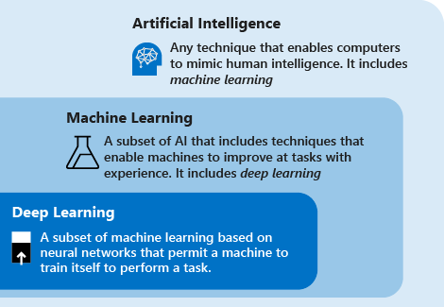
Deep learning, machine learning, and AI

Slide 5
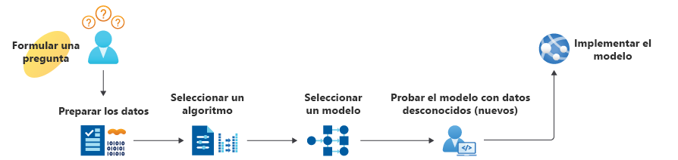
how it works?

Slide 6

GreenTech
Sustainable Software Engineering is an emerging discipline at the intersection of climate science, software, hardware, electricity markets, and data center design.

Slide 7

Check the next video.

Slide 8

Azure machine learning designer.
Is a cloud-based service that helps simplify some of the tasks and reduce the time it takes to prepare data, train a model, and deploy a predictive service

Slide 9
Exercise

Slide 10
Creating a machine learning model.

Slide 11
Code

Slide 13
What’s next?

Slide 14
What’s next?
Learn about:
Create machine learning models - Learn | Microsoft Docs
Understand data science for machine learning - Learn | Microsoft Docs
The Principles of Sustainable Software Engineering - Learn | Microsoft Docs
Be sure to give feedback about this workshop:
https://forms.office.com/r/MdhJWMZthR!

